Slide 1
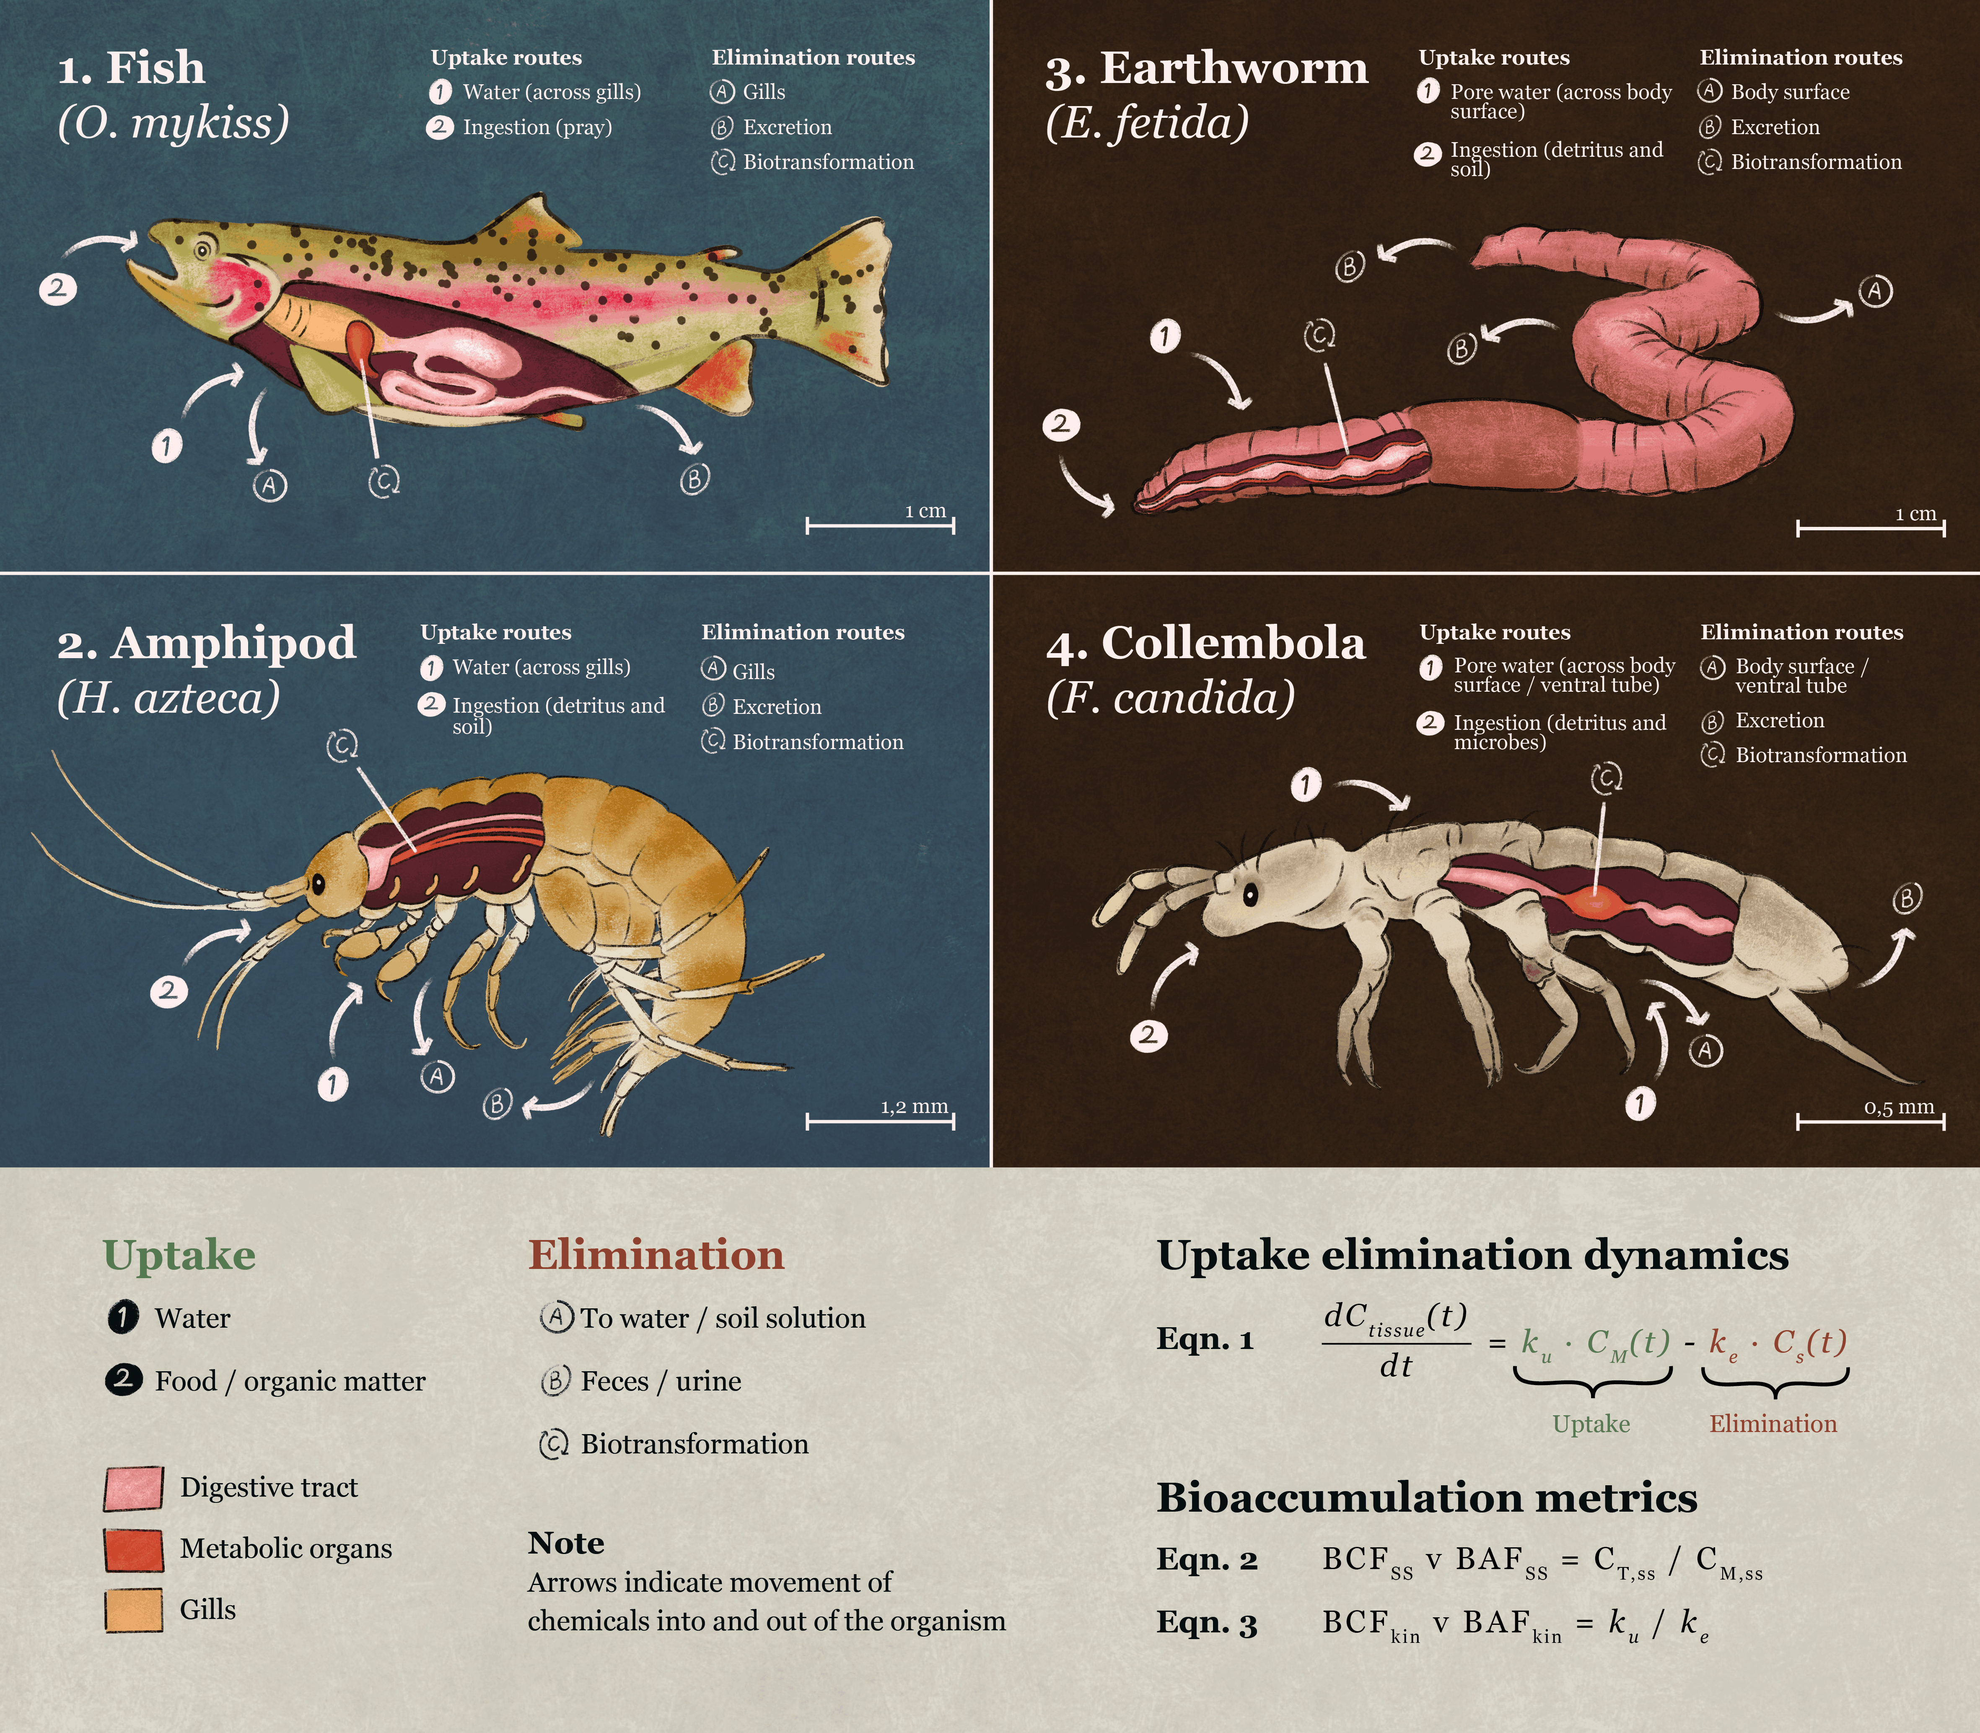


Bioaccumulation in Aquatic Organisms
From One-Compartment Toxicokinetic Models to Real-World Complexity
Johannes Raths
Eawag: Swiss Federal Institute of Aquatic Science and Technology, Switzerland
https://orcid.org/0000-0002-3258-0893
Raths, J.; Wehrli, M.; Langer, M.; Hollender, J. Bioaccumulation in a Changing Climate: Temperature-Driven Toxicokinetics in Aquatic and Terrestrial Ectotherms. CHIMIA 2026, 80 (10), 695–700. https://doi.org/10.2533/chimia.2026.695
University of Waterloo; November 12, 2026
©Eawag

Slide 2


Schedule
Course Materials
12th November 2026
https://github.com/HollenderGroup/Teaching_TK_Workshop_Waterloo_12.11.2026
13:00–13:15
Welcome and why bioaccumulation matters
13:15 – 13:30
Bioaccumulation – a kinetic problem
13:30–14:00
Exercise 1: The 1-compartment TK model
14:00-14:15
Plenary discussion of Exercise 1
14:15–14:45
Exercise 2: Biotransformation
14:45-15:00
Plenary discussion of Exercise 2
15:00–15:15
Coffee break
15:15–15:45
Exercise 3: Multiple compartment kinetics
15:45-16:00
Plenary discussion of Exercise 3
16:00–16:30
Outlook: Dietary uptake, temperature effects and others
16:30–17:00
Final discussion and Wrap-up

Slide 3
13:00–13:15 | Welcome and why bioaccumulation matters

Slide 4
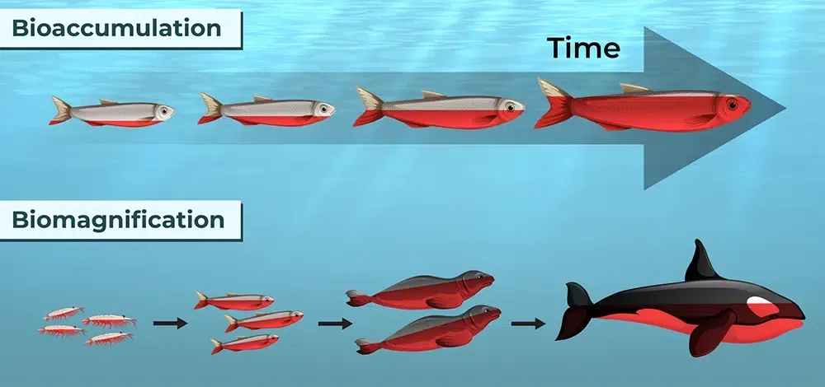


What is bioaccumulation?
The definitions
Bioaccumulation:
$$C_{Tissue }> C_{Medium}$$
https://www.geeksforgeeks.org/biology/biomagnification/
Biomagnification:
$$C_{Tissue }> C_{Diet}$$

Slide 5
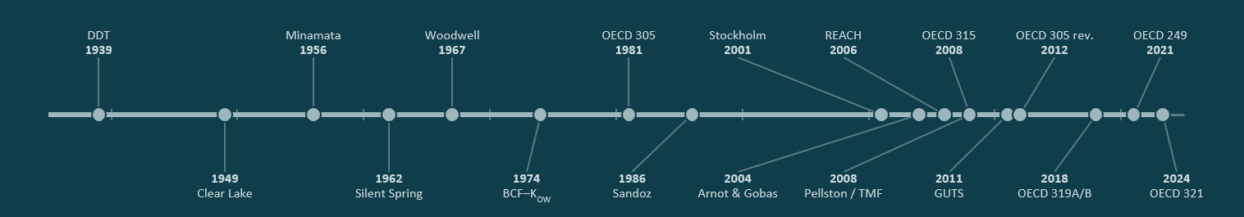
Why bioaccumulation matters
Historic and current examples of bioaccumulation

Slide 6
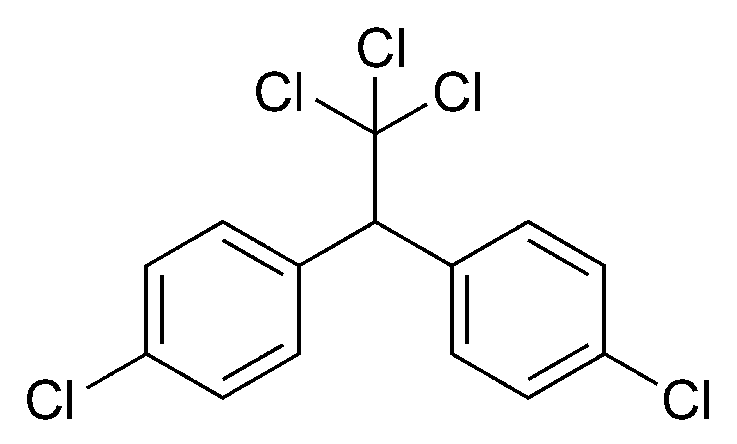
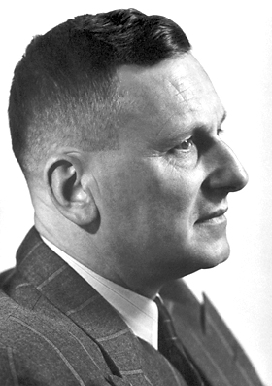

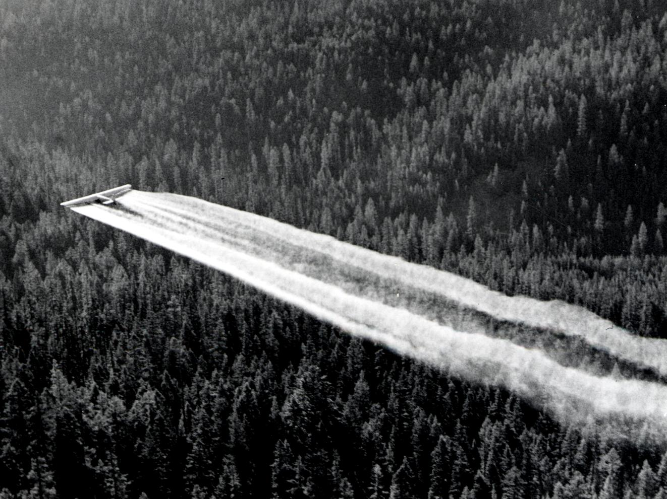
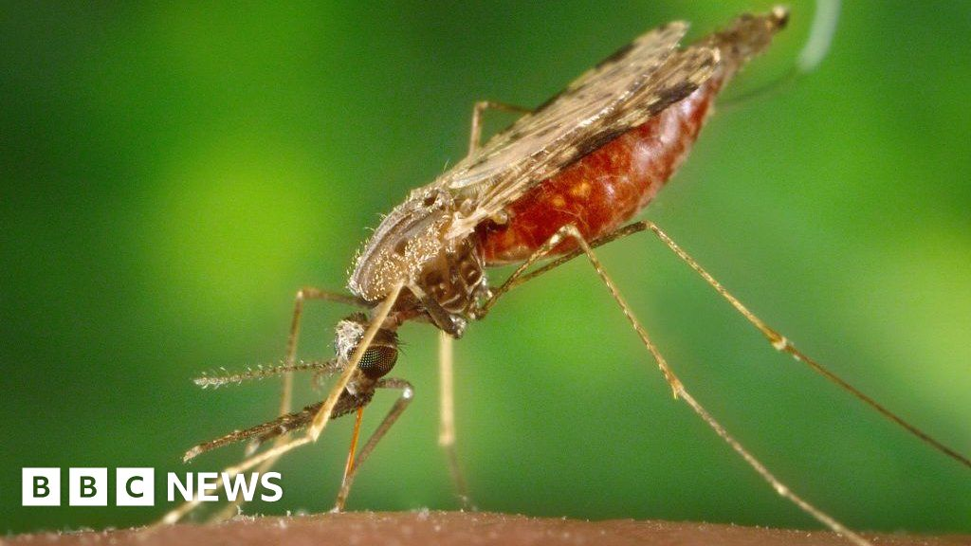
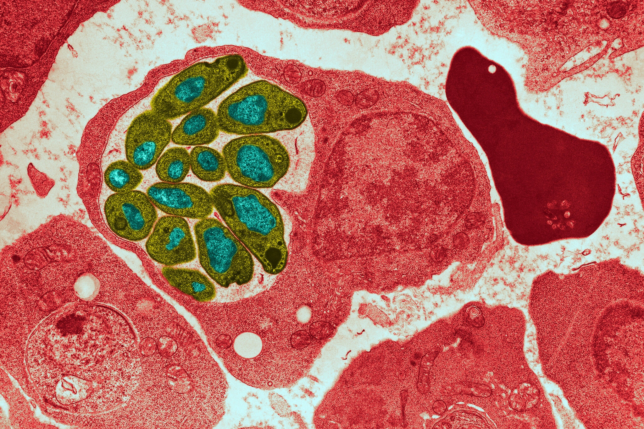
DDT
1939–1948
https://culturacientifica.com/2017/12/04/historias-la-malaria-paul-muller-ddt-rachel-carson/
Paul Müller discovered DDT’s insecticidal activity (Nobel Prize 1948). Its worldwide use led to the first large-scale cases of persistent, lipophilic chemicals building up in organisms.
DDT was first made in 1874 by the chemist Othmar Zeidler, but no use for it was found.
https://clickamericana.com/tag/poisons
https://www.nytimes.com/2020/10/26/health/malaria-parasites-genetics.html
DDT
1939

Slide 7
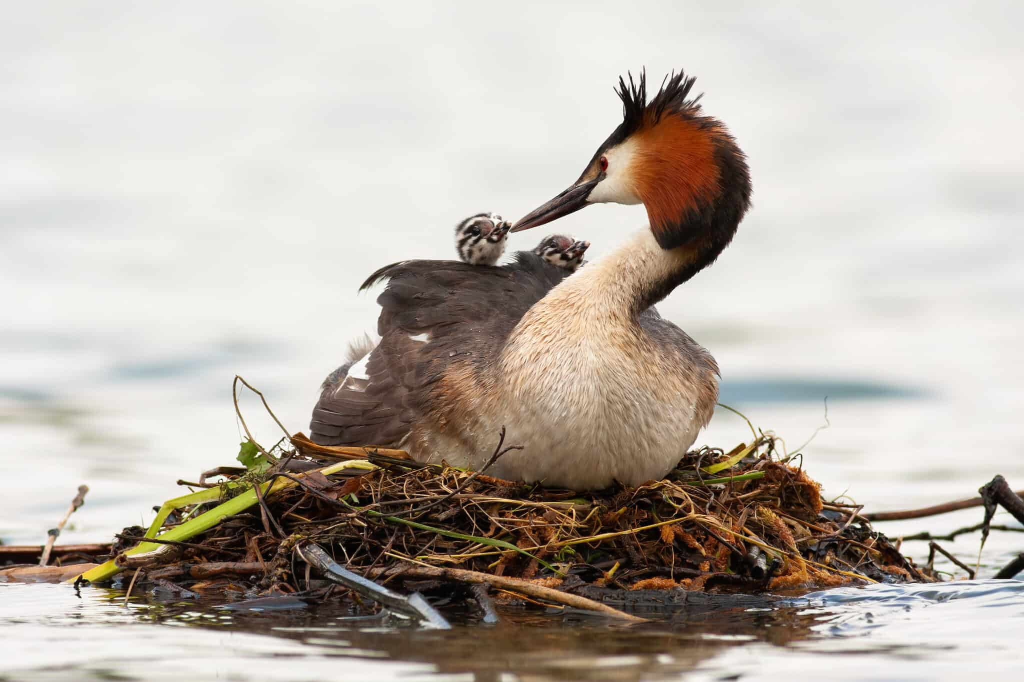
Clear Lake, California
1949–1957
DDD was applied to control gnats, and western grebes later died off. Residues in grebe fat were many orders of magnitude higher than in the water (Hunt & Bischoff, 1960).
This became a textbook case of biomagnification.
https://a-z-animals.com/animals/grebe/
DDT
1939
Hunt, E. G., & Bischoff, A. I. (1960). Inimical effects on wildlife of periodic DDD applications to Clear Lake. Calif. Fish Game, 46(1), 91-105.
1949
Clear Lake

Slide 8
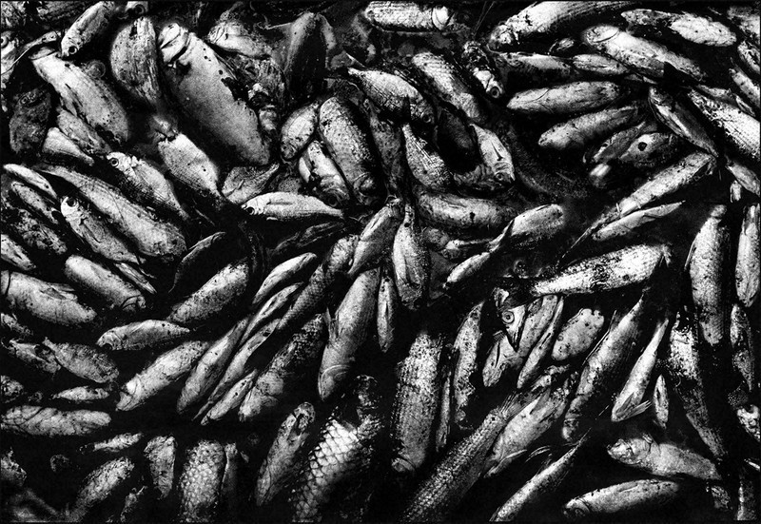
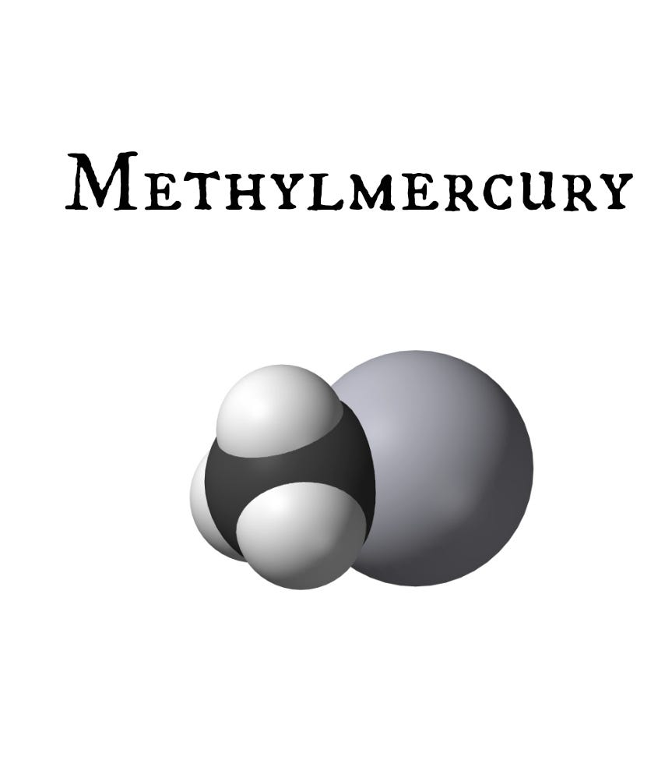
Minamata disease, Japan
1956
Methylmercury from Chisso’s wastewater accumulated in fish and shellfish and poisoned the people who ate them.
A second outbreak followed in Niigata in 1965. It showed that a metal could biomagnify once it was transformed into an organometallic form.
https://mainichi.jp/english/graphs/20211221/hpe/00m/0na/001000g/20211221hpe00m0na004000q
https://news.immunologic.org/p/vaccines-dont-contain-harmful-mercury
DDT
1939
Minamata
1956
1949
Clear Lake

Slide 9
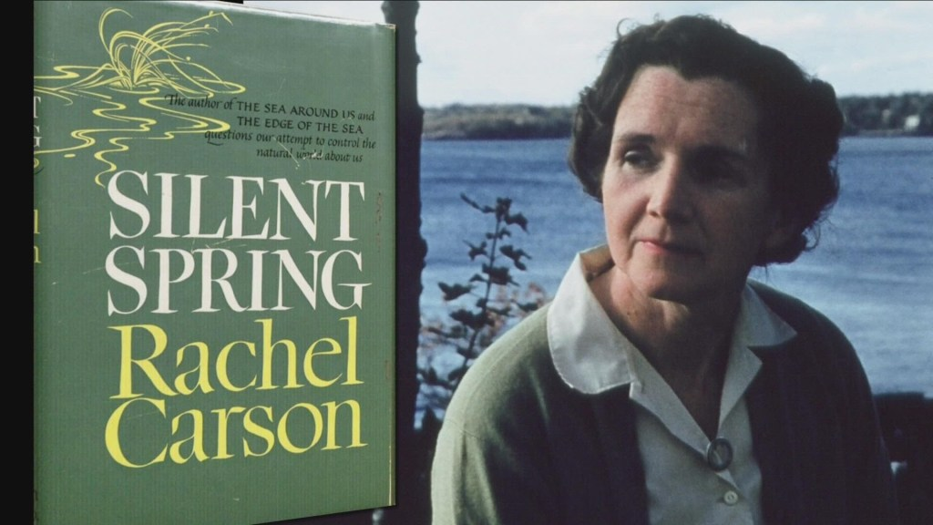
Rachel Carson’s Silent Spring
1962
It brought food-chain accumulation of pesticides to public attention and triggered regulation.
https://theenvironmentconsultant.com/2025/05/14/silent-spring-the-book-that-sparked-the-global-environmental-movement/
DDT
1939
Minamata
1956
1949
Clear Lake
1962
Silent Spring

Slide 10
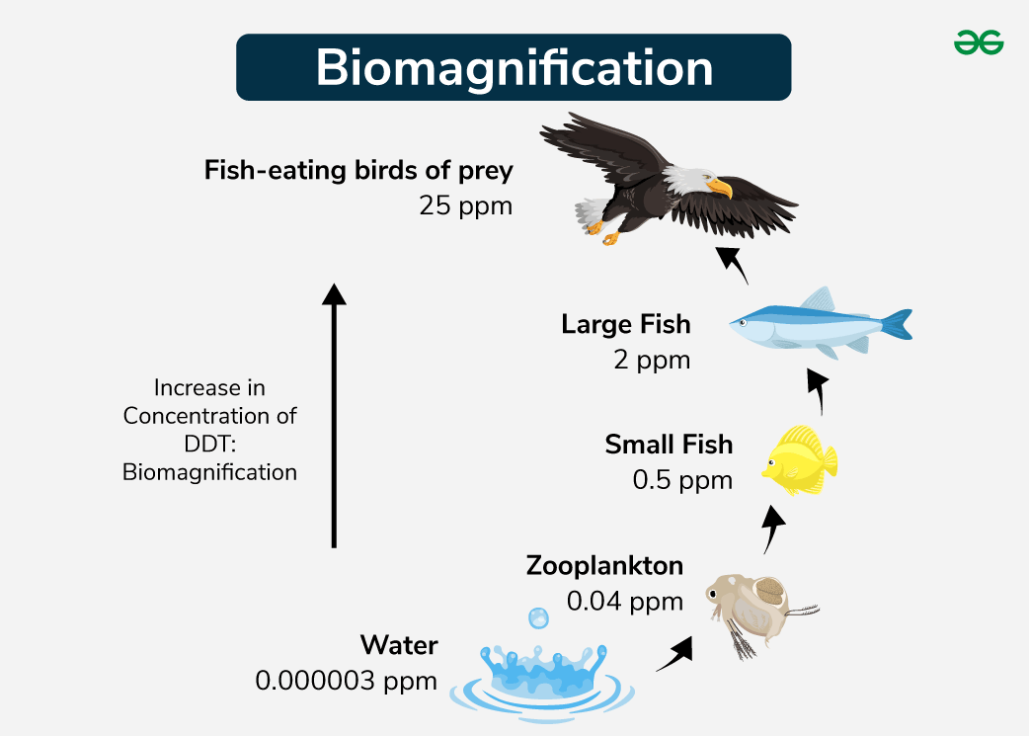
Case study: DDT Biomagnification
1967
DDT increasing up an estuarine food web.
Woodwell, G. M.; Wurster, C. F.; Isaacson, P. A. DDT Residues in an East Coast Estuary: A Case of Biological Concentration of a Persistent Insecticide. Science 1967, 156 (3776), 821–824. https://doi.org/10.1126/science.156.3776.821
https://www.geeksforgeeks.org/biology/biomagnification/
DDT
1939
Minamata
1956
Woodwell
1967
1949
Clear Lake
1962
Silent Spring

Slide 11
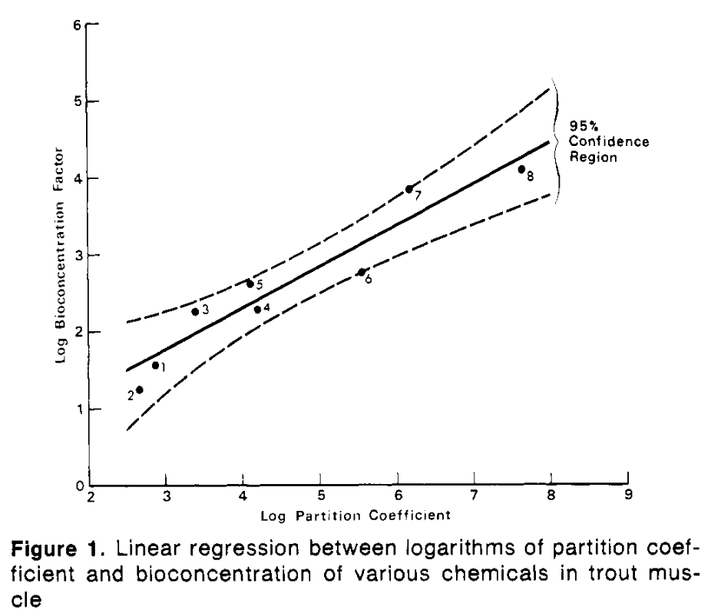
First QSAR approaches
1974
Correlation of the bioconcentration factor (BCF) in fish with octanol–water partition coefficient (K_{OW}).
This began quantitative structure–activity approaches to bioaccumulation.
Neely, W. B., Branson, D. R., & Blau, G. E. (1974). Partition coefficient to measure bioconcentration potential of organic chemicals in fish. Environmental Science & Technology, 8(13), 1113-1115.
DDT
1939
Minamata
1956
Woodwell
1967
1949
Clear Lake
1962
Silent Spring
1974
BCF–K_{OW}

Slide 12
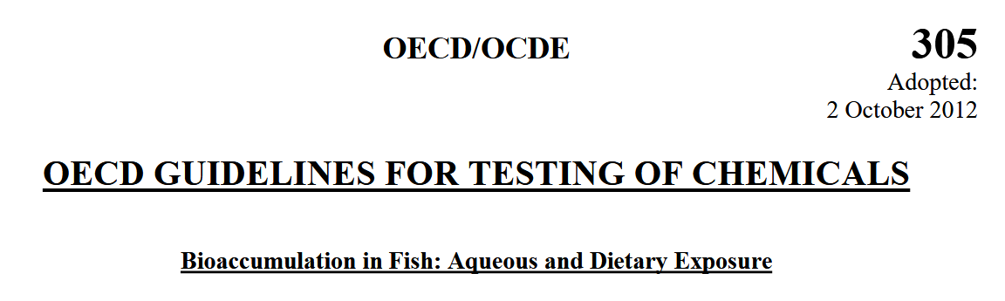
OECD Test Guideline 305
1981
First standardised fish bioconcentration test with an uptake and a depuration phase.
OECD. Test No. 305: Bioaccumulation in Fish: Aqueous and Dietary Exposure; OECD publishing, 2012.
DDT
1939
Minamata
1956
Woodwell
1967
OECD 305
1981
1949
Clear Lake
1962
Silent Spring
1974
BCF–K_{OW}

Slide 13
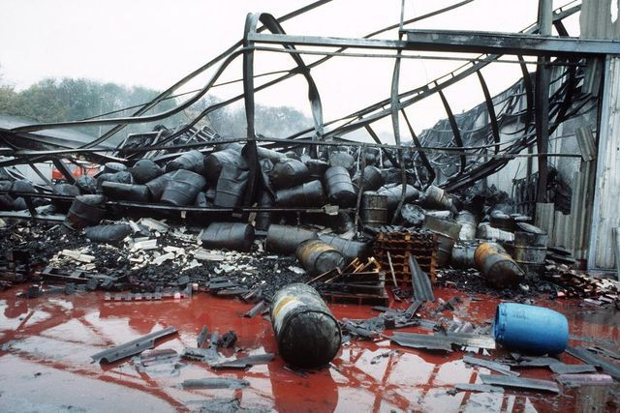
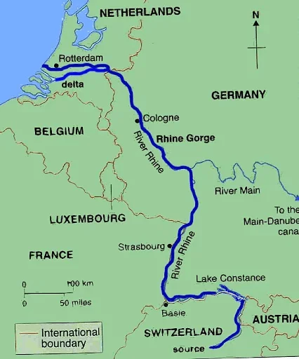
Sandoz/Schweizerhalle fire, Basel
1986
Organophosphates
Metoxuron
Organomercury fungicides
Rhodamine B
https://www.bazonline.ch/schweizerhalle-brandort-wird-ueberwacht-871766357220
Pesticides and mercury compounds were released into the Rhine.
This had a large impact on Swiss and European water research, including at Eawag.
DDT
1939
Minamata
1956
Woodwell
1967
OECD 305
1981
https://www.iasgyan.in/daily-current-affairs/rhine-river
1949
Clear Lake
1962
Silent Spring
1974
BCF–K_{OW}
1986
Sandoz

Slide 14

Stockholm Convention (in force 2004)
2001
Definition of the bioaccumulation criterion:
BCF or bioaccumulation factor (BAF) > 5000
DDT
1939
Minamata
1956
Woodwell
1967
OECD 305
1981
Stockholm
2001
1949
Clear Lake
1962
Silent Spring
1974
BCF–K_{OW}
1986
Sandoz

Slide 15
First extensive Reviews
2004–2006
Arnot, J. A.; Gobas, F. A. P. C. A Food Web Bioaccumulation Model for Organic Chemicals in Aquatic Ecosystems. Environmental Toxicology and Chemistry 2004, 23 (10), 2343–2355. https://doi.org/10.1897/03-438
Arnot & Gobas published a widely used food-web bioaccumulation model and a critical review of measured BCF/BAF data.
Arnot, J. A.; Gobas, F. A. A Review of Bioconcentration Factor (BCF) and Bioaccumulation Factor (BAF) Assessments for Organic Chemicals in Aquatic Organisms. Environ. Rev. 2006, 14 (4), 257–297. https://doi.org/10.1139/a06-005
DDT
1939
Minamata
1956
Woodwell
1967
OECD 305
1981
Stockholm
2001
1949
Clear Lake
1962
Silent Spring
1974
BCF–K_{OW}
1986
Sandoz
2004
Arnot & Gobas

Slide 16
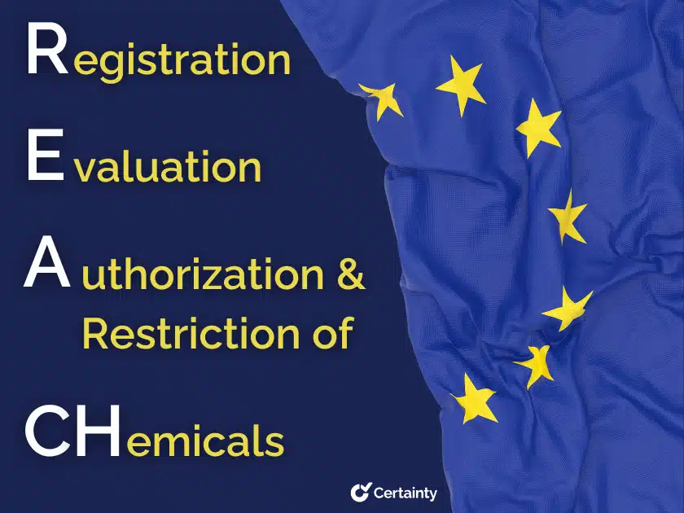
EU REACH
2006/2007
PBT/vPvB criteria (Annex XIII) defined: Bioaccumulative (B): BCF > 2000
Very Bioaccumulative (vB): BCF > 5000.
https://www.certaintysoftware.com/eu-reach-regulation/
DDT
1939
Minamata
1956
Woodwell
1967
OECD 305
1981
Stockholm
2001
REACH
2006
1949
Clear Lake
1962
Silent Spring
1974
BCF–K_{OW}
1986
Sandoz
2004
Arnot & Gobas

Slide 17

SETAC Pellston workshop
2008–2009
Bioaccumulation assessment in the field:
Trophic magnification factors (TMFs)
Fremlin, K. M.; Elliott, J. E.; Gobas, F. A. P. C. Guidance for Measuring and Evaluating Biomagnification Factors and Trophic Magnification Factors of Difficult Substances: Application to Decabromodiphenylethane. Integr Environ Assess Manag 2025, 21 (2), 263–278. https://doi.org/10.1093/inteam/vjae025
DDT
1939
Minamata
1956
Woodwell
1967
OECD 305
1981
Stockholm
2001
REACH
2006
1949
Clear Lake
1962
Silent Spring
1974
BCF–K_{OW}
1986
Sandoz
2004
Arnot & Gobas
2008
Pellston / TMF

Slide 18
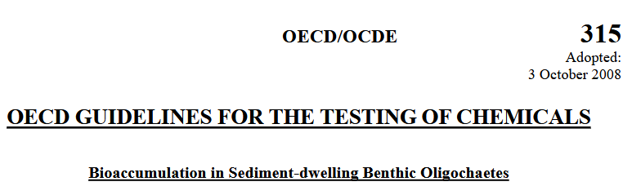
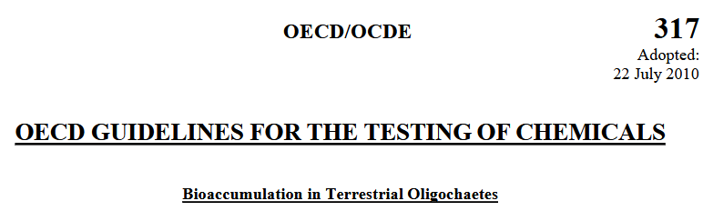
OECD TG 315 / 317
2008-2010
Bioaccumulation test with sediment-dwelling oligochaete worms and earthworms in soil.
OECD. Test No. 315: Bioaccumulation in Sediment-Dwelling Benthic Oligochaetes; OECD Guidelines for the Testing of Chemicals, Section 3; OECD, 2008. https://doi.org/10.1787/9789264067516-en
OECD. Test No. 317: Bioaccumulation in Terrestrial Oligochaetes; OECD Guidelines for the Testing of Chemicals, Section 3; OECD, 2010. https://doi.org/10.1787/9789264090934-en
DDT
1939
Minamata
1956
Woodwell
1967
OECD 305
1981
Stockholm
2001
REACH
2006
OECD 315/317
2008
1949
Clear Lake
1962
Silent Spring
1974
BCF–K_{OW}
1986
Sandoz
2004
Arnot & Gobas
2008
Pellston / TMF

Slide 19
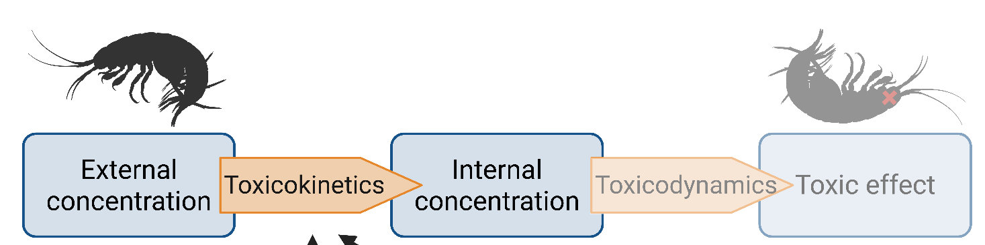
GUTS
2011
The General Unified Threshold model of Survival unified TK-TD survival models.
It is now part of EFSA’s guidance for pesticide risk assessment.
Jager, T.; Albert, C.; Preuss, T. G.; Ashauer, R. General Unified Threshold Model of Survival - a Toxicokinetic-Toxicodynamic Framework for Ecotoxicology. Environ. Sci. Technol. 2011, 45 (7), 2529–2540. https://doi.org/10.1021/es103092a
DDT
1939
Minamata
1956
Woodwell
1967
OECD 305
1981
Stockholm
2001
REACH
2006
OECD 315/317
2008
1949
Clear Lake
1962
Silent Spring
1974
BCF–K_{OW}
1986
Sandoz
2004
Arnot & Gobas
2008
Pellston / TMF
2011
GUTS

Slide 20
OECD 305 revision
2012
It added a dietary exposure test for very hydrophobic chemicals and a reduced-fish (“minimized”) design.
DDT
1939
Minamata
1956
Woodwell
1967
OECD 305
1981
Stockholm
2001
REACH
2006
OECD 315/317
2008
OECD 305 rev.
2012
1949
Clear Lake
1962
Silent Spring
1974
BCF–K_{OW}
1986
Sandoz
2004
Arnot & Gobas
2008
Pellston / TMF
2011
GUTS

Slide 21
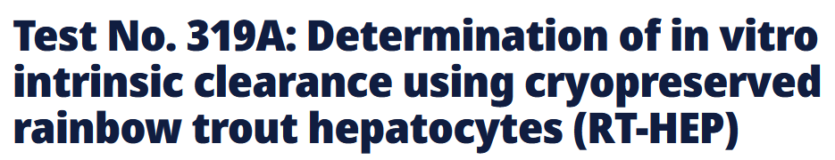
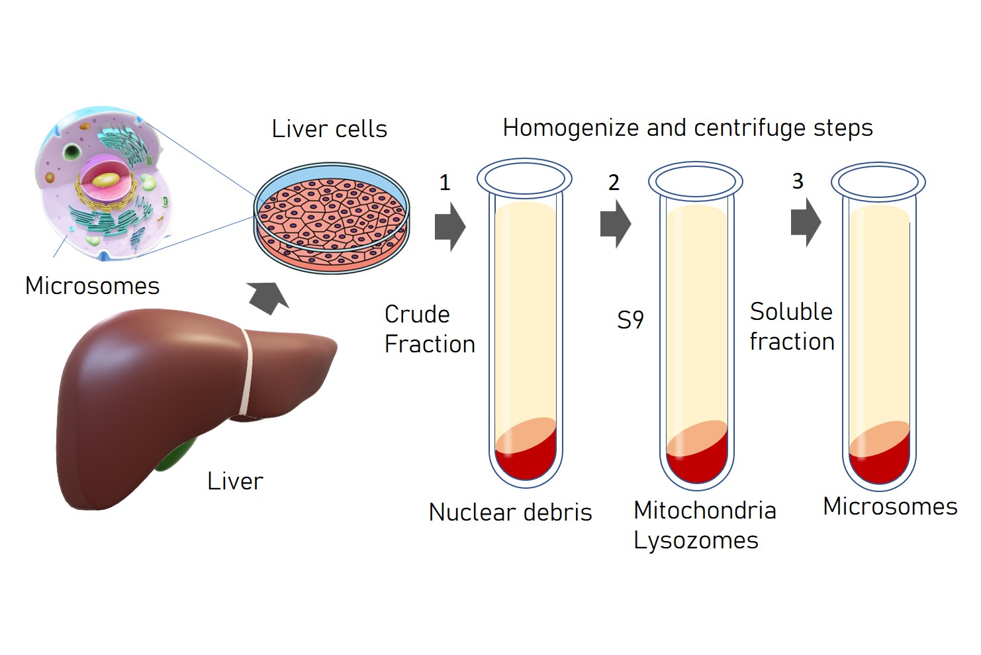
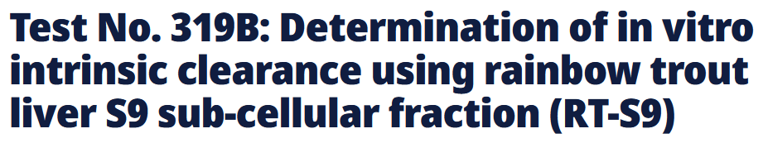
OECD TG 319A/B
2018
In vitro biotransformation tests using rainbow trout liver cells and liver S9 fractions.
Combined with in vitro–in vivo extrapolation (IVIVE), they help predict BCFs with fewer fish.
DDT
1939
Minamata
1956
Woodwell
1967
OECD 305
1981
Stockholm
2001
REACH
2006
OECD 315/317
2008
OECD 305 rev.
2012
1949
Clear Lake
1962
Silent Spring
1974
BCF–K_{OW}
1986
Sandoz
2004
Arnot & Gobas
2008
Pellston / TMF
2011
GUTS
2018
OECD 319A/B

Slide 22
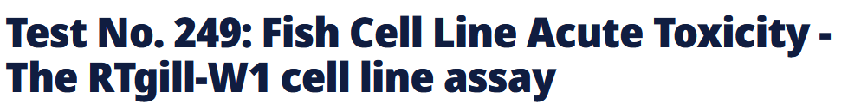
OECD TG 249
2021
The RTgill-W1 fish gill cell line assay (developed at Eawa). It is a 3R alternative for fish acute toxicity (not bioaccumulation)
But:
Such assays can also be used for bioaccumulation estimation (i.e. Stadnicka-Michalak et al., 2018)
Stadnicka-Michalak, J.; Weiss, F. T.; Fischer, M.; Tanneberger, K.; Schirmer, K. Biotransformation of Benzo[a]Pyrene by Three Rainbow Trout (Onchorhynchus Mykiss) Cell Lines and Extrapolation To Derive a Fish Bioconcentration Factor. Environ. Sci. Technol. 2018, 52 (5), 3091–3100. https://doi.org/10.1021/acs.est.7b04548
DDT
1939
Minamata
1956
Woodwell
1967
OECD 305
1981
Stockholm
2001
REACH
2006
OECD 315/317
2008
OECD 305 rev.
2012
OECD 249
2021
1949
Clear Lake
1962
Silent Spring
1974
BCF–K_{OW}
1986
Sandoz
2004
Arnot & Gobas
2008
Pellston / TMF
2011
GUTS
2018
OECD 319A/B

Slide 23
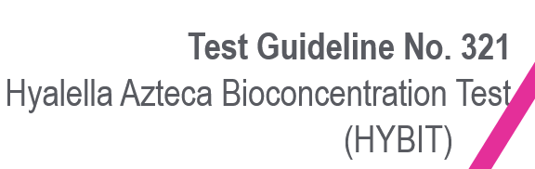
OECD TG 321
2024
A bioconcentration test with the freshwater amphipod Hyalella azteca, an invertebrate alternative to fish tests.
OECD. Test No. 321: Hyallela Azteca Bioconcentration Test (HYBIT); OECD Guidelines for the Testing of Chemicals, Section 3; OECD, 2024. https://doi.org/10.1787/8ac30c4e-en
DDT
1939
Minamata
1956
Woodwell
1967
OECD 305
1981
Stockholm
2001
REACH
2006
OECD 315/317
2008
OECD 305 rev.
2012
OECD 249
2021
1949
Clear Lake
1962
Silent Spring
1974
BCF–K_{OW}
1986
Sandoz
2004
Arnot & Gobas
2008
Pellston / TMF
2011
GUTS
2018
OECD 319A/B
2024
OECD 321

Slide 24
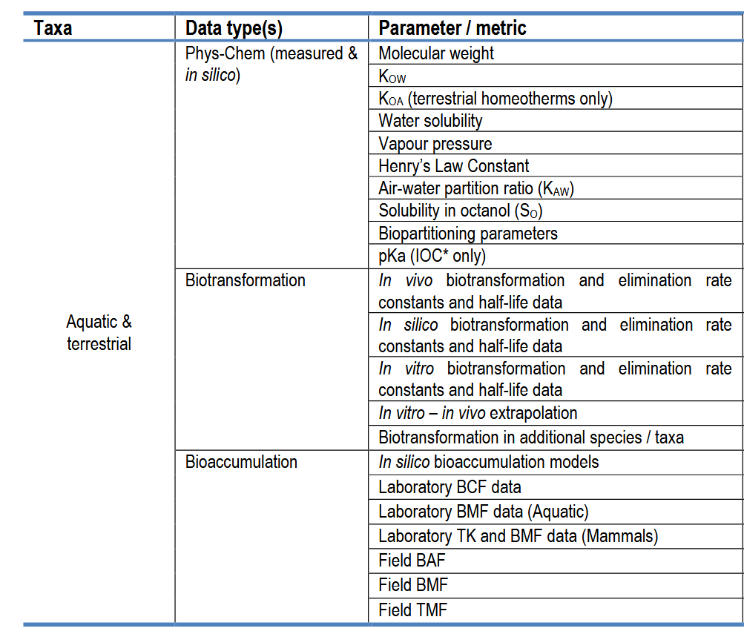
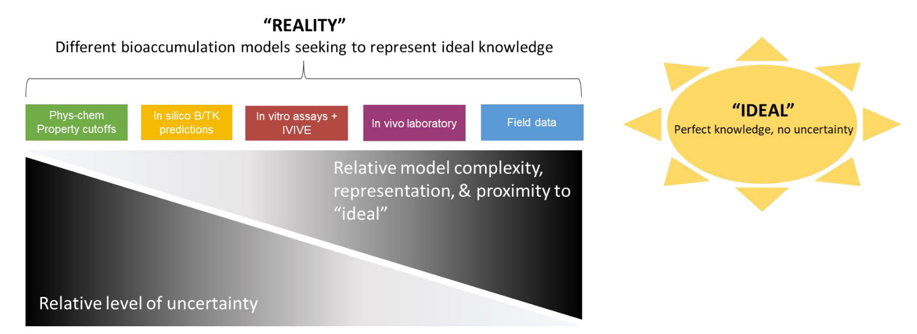
Bioaccumulation assessment framework
Regulatory requirement:
OECD TG 305 (default)
OECD TG 321 (alternative, EU)
OECD. Case Study on the Use of Integrated Approaches for Testing and Assessment (IATA) for Bioaccumulation ‑ Ninth Review Cycle (2023). OECD Series on Testing and Assessment 2024. https://doi.org/10.1787/8bc8ad6f-en
Supporting evidence only:
OECD TG 315/317
OECD TG 319A/B

Slide 25
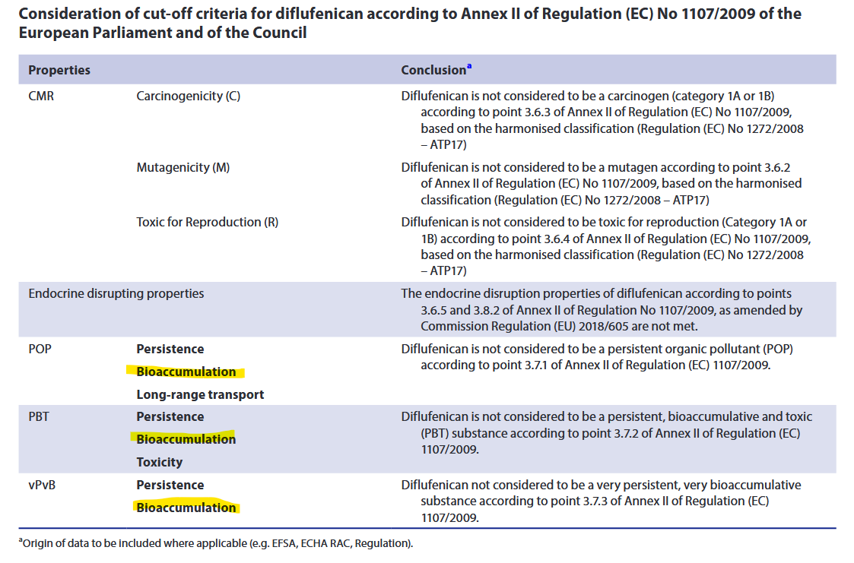
Regulatory cut-off criteria
Europe:
B = BCF >2000
vB = BCF >5000

Slide 26
13:15 – 13:30 | Bioaccumulation – a kinetic problem

Slide 27
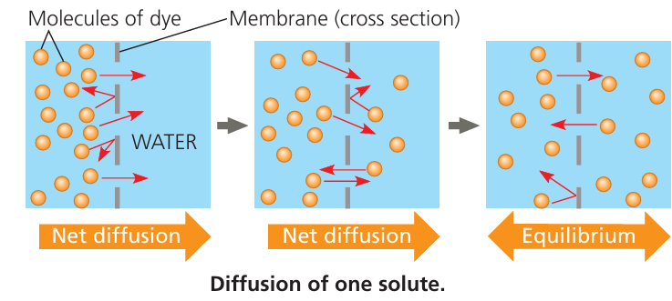
Bioaccumulation – a kinetic problem
Diffusion
https://www.iitianacademy.com/ib-myp-programme/ib-myp-4-5-biology-revision-resources/ib-myp-4-5-biology-diffusion-study-notes/
(or Steady State for living organisms)

Slide 28
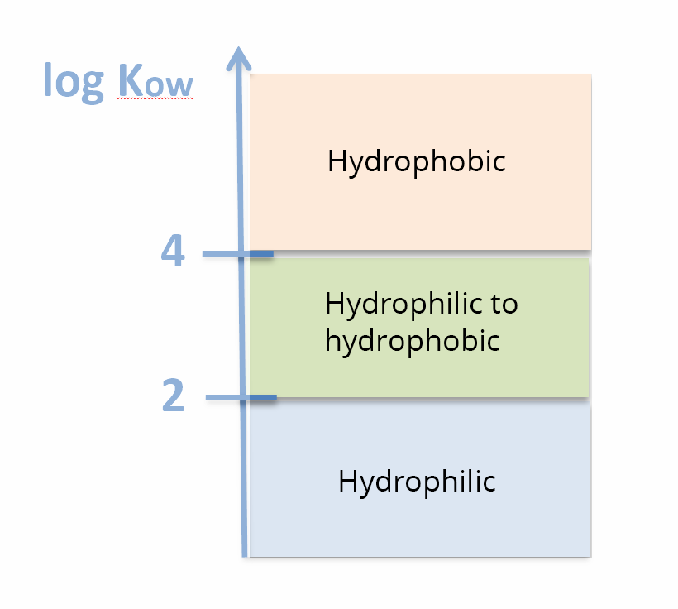
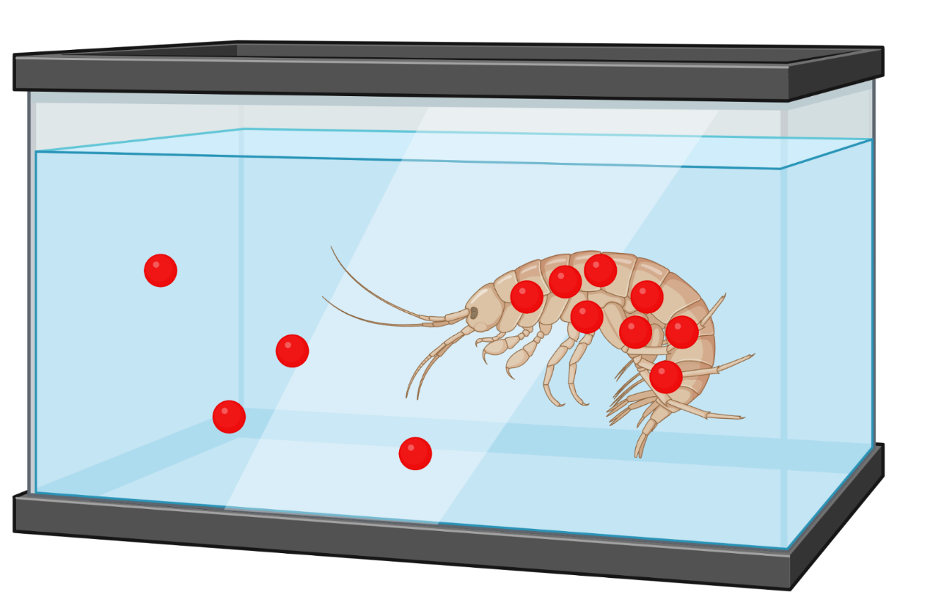
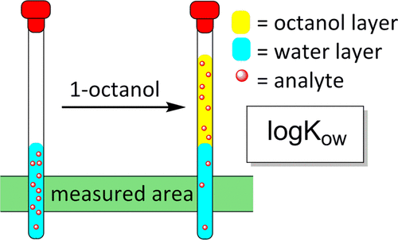
Bioaccumulation – a kinetic problem
Partitioning
https://www.neuraldesigner.com/blog/octanol_water_partition_coeff_prediction/

Slide 29
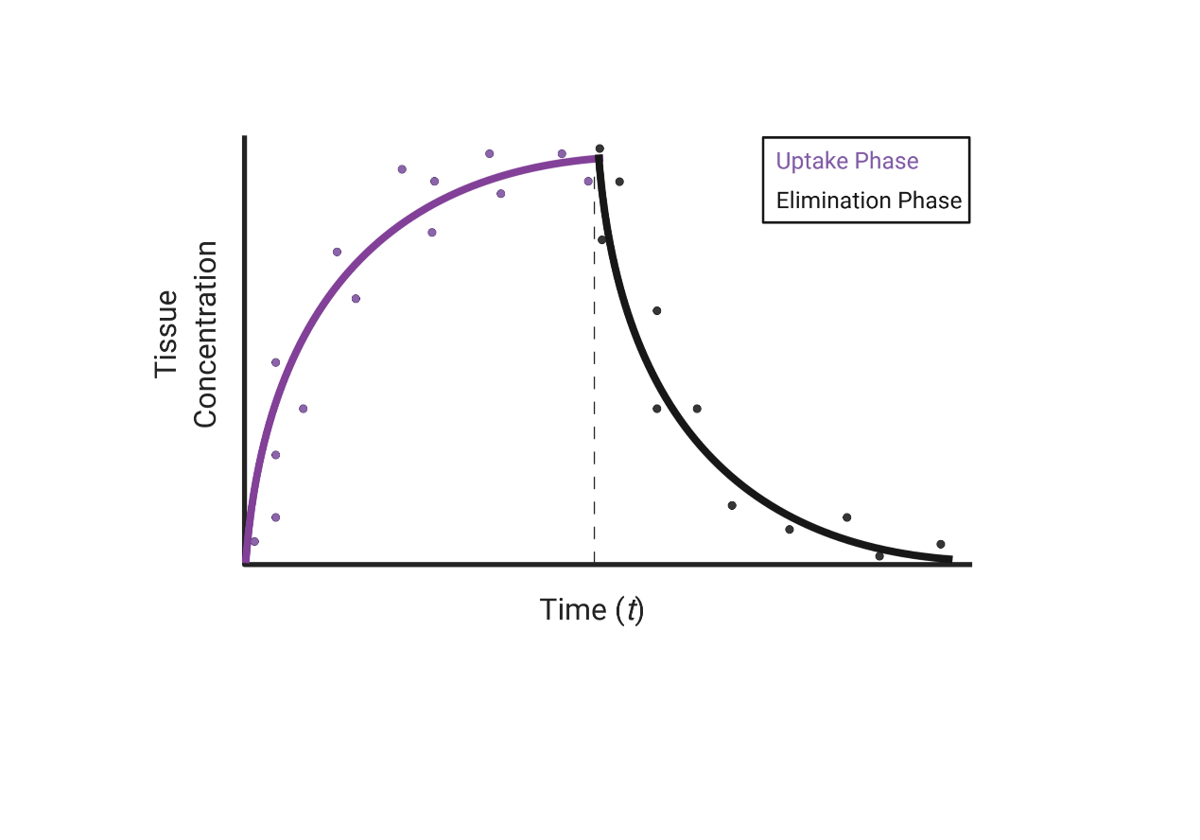
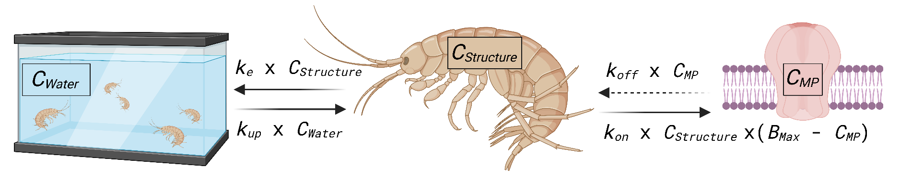
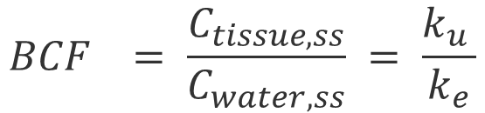
Bioaccumulation – a kinetic problem
$${BCF}_{}= \frac{C_{tissue, ss}}{C_{water, ss}} = \frac{k_{u }}{k_{e}}$$
One-compartment model
Steady State
$$\frac{\left.dC_{Structure}(t\right)}{dt}=k_{u} ∙ C_{water}(t) − k_{e} ∙ C_{Structure}(t)$$

Slide 30
Bioaccumulation – a kinetic problem
Carter, L. J.; Ashauer, R.; Ryan, J. J.; Boxall, A. B. A. Minimised Bioconcentration Tests: A Useful Tool for Assessing Chemical Uptake into Terrestrial and Aquatic Invertebrates? Environ. Sci. Technol. 2014, 48 (22), 13497–13503. https://doi.org/10.1021/es5031992
Sampling procedure
OECD 305 Standard
OECD 305 Minimized
Steady State
Steady State
Limitations:
- Uses a lot of animals
Limitations:
No steady state confirmation
How to interpret elimination??

Slide 31
Bioaccumulation – a kinetic problem
From laboratory to mesocosm: (Sumbmitted, ES&T Toxicology) Temperature and species dependent toxicokinetics of the fluorinated herbicide Diflufenican Johannes Raths^{1,2}*, Clemens Stäuble^{1,2}, Markus Hermann¹, Juliane Hollender^{1,2}
Sampling procedure
Steady State
2
1
Confirms Steady State & provides k_e
Kind of necessary
Provides k_e & check for multi-compartment
Check for multi-compartment
3
4
Limitations:
- Finding good estimates ~dt50

Slide 32
13:30–14:00 | Exercise 1:
The standard 1-compartment TK model

Slide 33
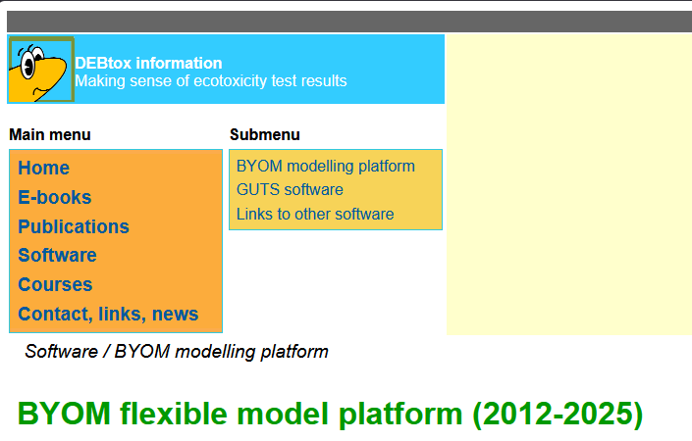



Wehrli, M.; Raths, J. O.; de Courten, A.; Maccagnan, A.; Fenner, K.; Junghans, M.; Renaud, M.; Langer, M.
Pesticides Never Walk Alone: Mixture Toxicity and Toxicokinetics of Five Formulated Pesticide Products in the Soil Arthropod Folsomia Candida. Social Science Research Network: Rochester, NY August 27, 2026.
https://doi.org/10.2139/ssrn.6832346
https://www.debtox.info/byom.html
https://github.com/HollenderGroup/Bioaccumulation_TK-metabolism
https://github.com/HollenderGroup/Bioaccumulation_TK-metabolism_arrhenius

Slide 34
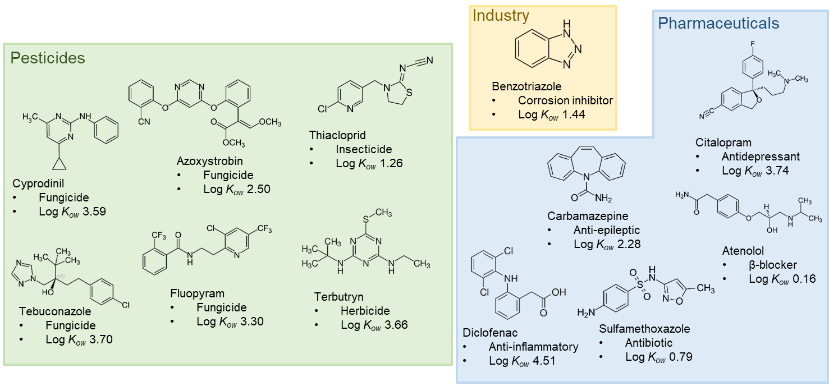
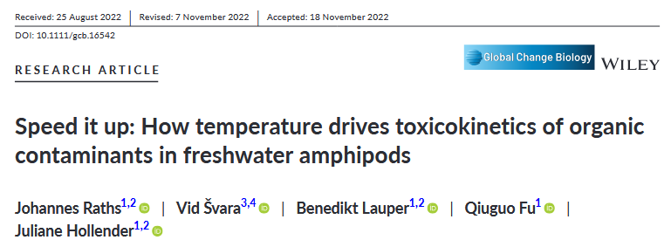
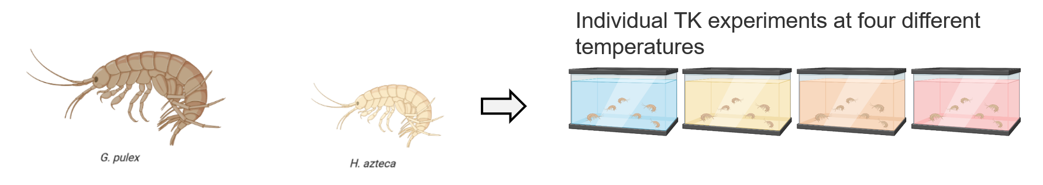
Dataset
12 compounds x 2 species x 4 temperatures
Task:
Choose your favorite compound and species
→ Run the model!

Slide 35
14:00-14:15 | Plenary discussion of Exercise 1

Slide 36
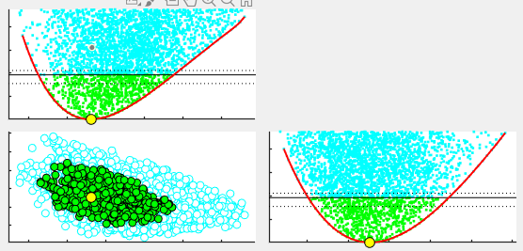
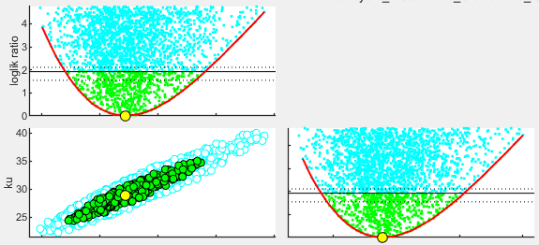
Parameter Space Explorer
How to read and interpret
Less dependency
Parameters (k_e, k_u) well defined
Slight dependency

Slide 37
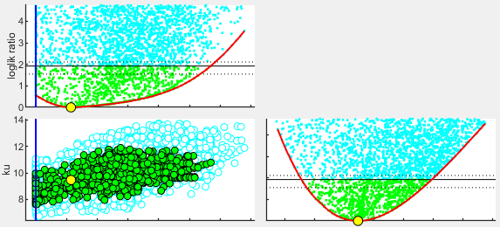
Parameter Space Explorer
How to read and interpret
k_e meets lower boundary

Slide 38
14:15–14:45 | Exercise 2: Biotransformation

Slide 39
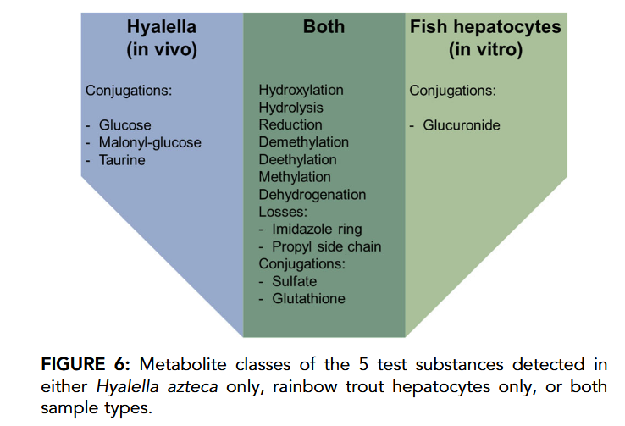
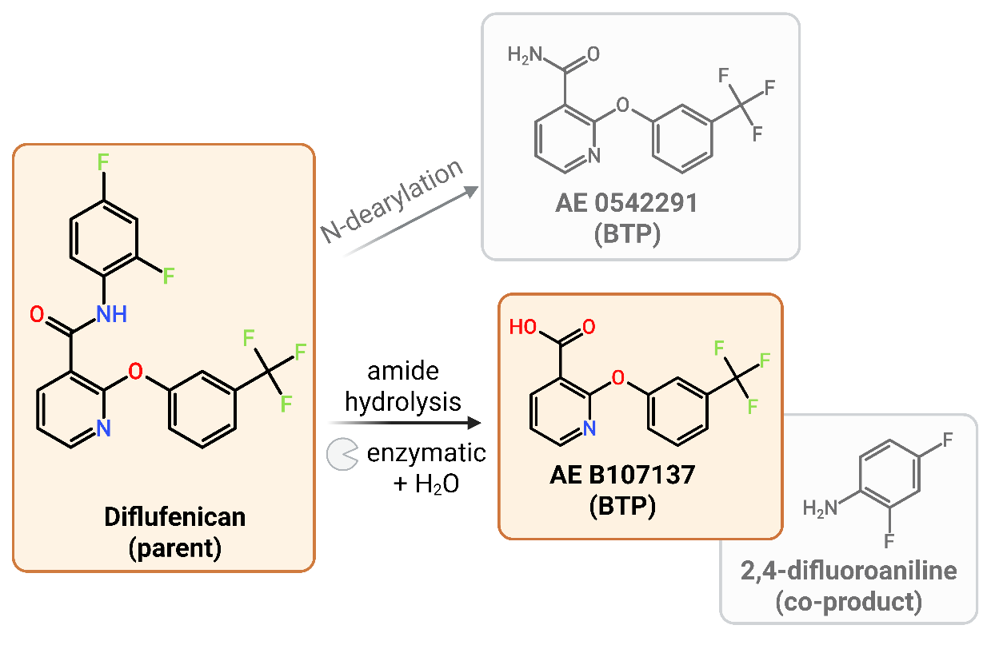
Biotransformation
Species specific transformation
Diflufenican
Kosfeld, V.; Fu, Q.; Ebersbach, I.; Esser, D.; Schauerte, A.; Bischof, I.; Hollender, J.; Schlechtriem, C.
Comparison of Alternative Methods for Bioaccumulation Assessment: Scope and Limitations of In Vitro Depletion Assays with Rainbow Trout and Bioconcentration Tests in the Freshwater Amphipod Hyalella Azteca. Environmental Toxicology and Chemistry 2020, 39 (9), 1813–1825. https://doi.org/10.1002/etc.4791
From laboratory to mesocosm: (Sumbmitted, ES&T Toxicology) Temperature and species dependent toxicokinetics of the fluorinated herbicide Diflufenican Johannes Raths^{1,2}*, Clemens Stäuble^{1,2}, Markus Hermann¹, Juliane Hollender^{1,2}

Slide 40
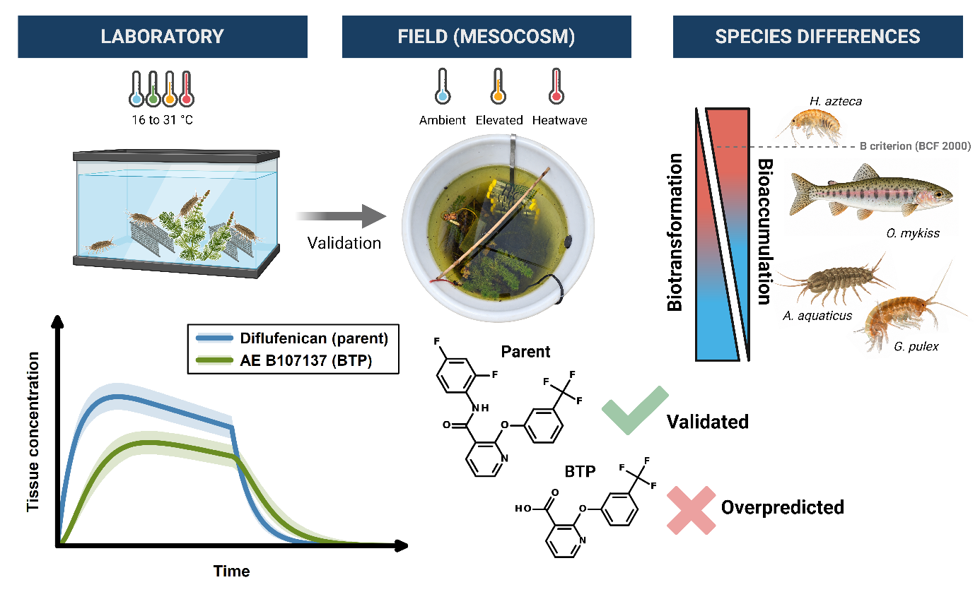
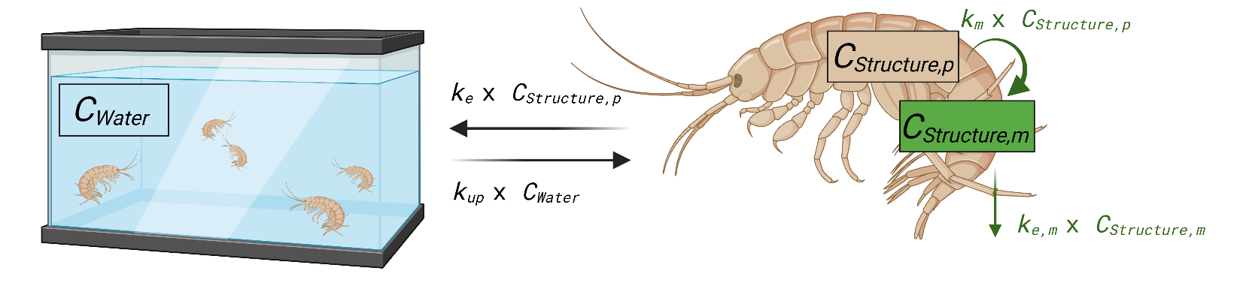
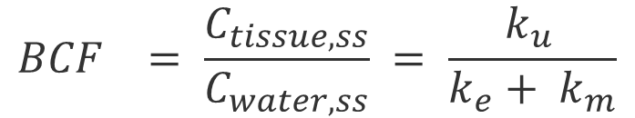
Biotransformation
$${BCF}_{}= \frac{C_{tissue, ss}}{C_{water, ss}} = \frac{k_{u }}{k_{e}+ k_{m}}$$
One-compartment model
$$\frac{\left.dC_{structure,p}(t\right)}{dt}=k_{u} ∙ C_{water}\left(t\right)− k_{e} ∙ C_{structure,p}\left(t\right)−k_{m} ∙ C_{structure,p}\left(t\right)$$
$$\frac{dC_{structure,m}\left(t\right)}{dt}={k_{m}⋅ C}_{structure,p}\left(t\right)−k_{e,m}{⋅C}_{structure,m}\left(t\right)$$

Slide 41
Biotransformation
Mass Balance
The unit for biochemical processes is mol!
  Biotransformation
  Receptor interactions
  …
1 g Diflufenican + 0.05 g H₂O → 0.72 g AE B107137 + 0.33 g 2,4-Difluoroaniline
Easier modeling using mol:
1 mol Diflufenican + 1 mol H₂O → 1 mol AE B107137 + 1 mol 2,4-Difluoroaniline

Slide 42
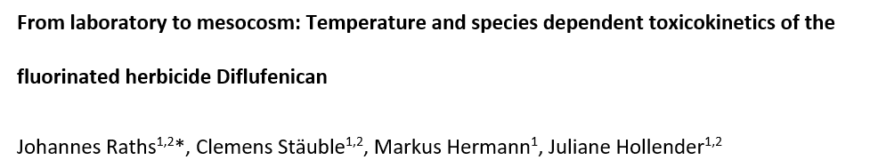
Dataset
1 Species, 1 compound
Task:
Run the model for different Experiments
(i.e. AE0, AE1, AE0 + AE1)

Slide 43
14:45-15:00 | Plenary discussion of Exercise 2

Slide 44
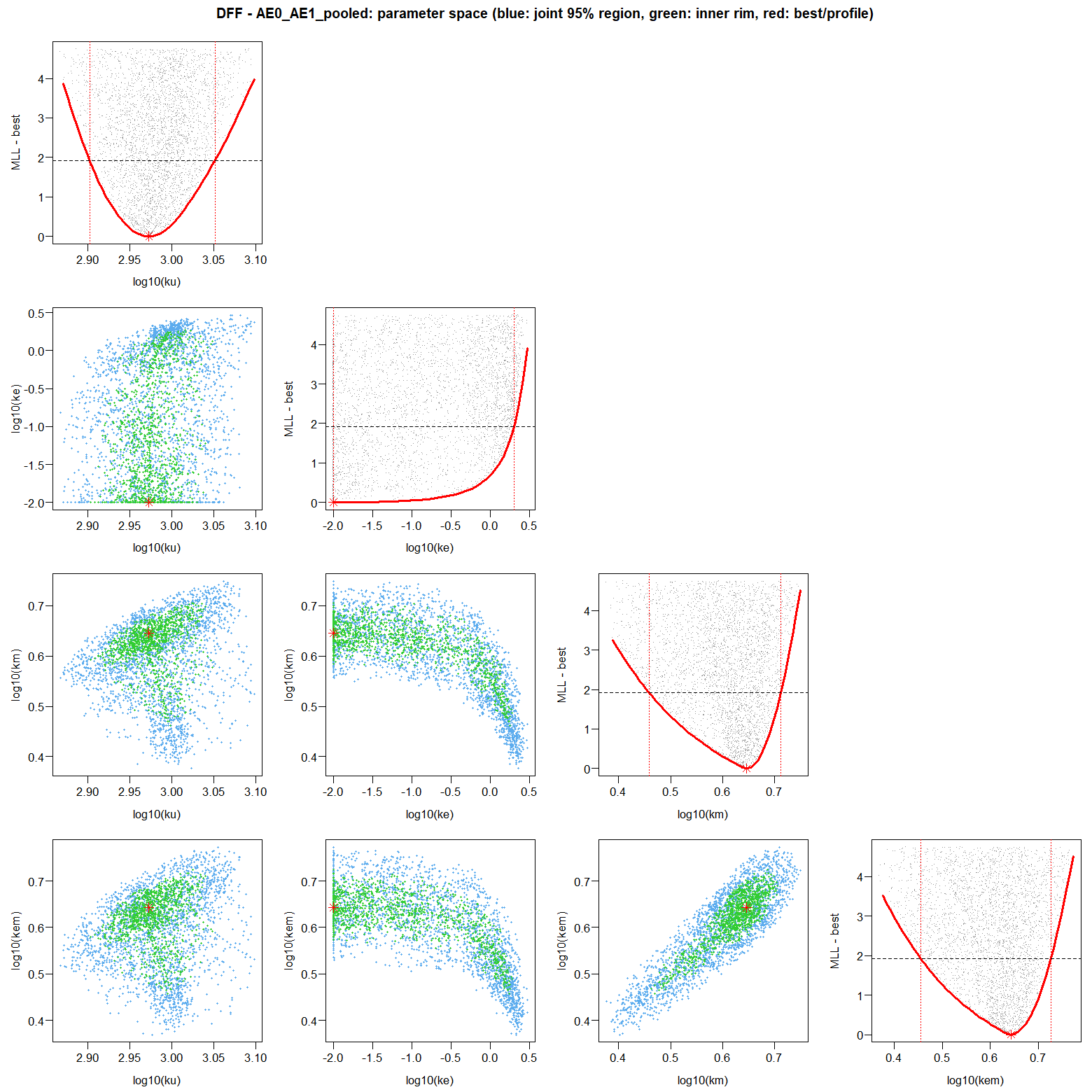
Uncertanties:
Overparametrization

Slide 45


More complex pathways
Reduction:
Only use BTPs > 5%
Only use Total BTPs
Phase I and Phase II
Rösch, A.; Anliker, S.; Hollender, J.
How Biotransformation Influences Toxicokinetics of Azole Fungicides in the Aquatic Invertebrate Gammarus Pulex. Environ. Sci. Technol. 2016, 50 (13), 7175–7188. https://doi.org/10.1021/acs.est.6b01301

Slide 46
15:00–15:15 | Coffee break

Slide 47
15:15–15:45 | Exercise 3: Multiple compartment kinetics

Slide 48

Multiple compartment kinetics
Indications for multiple compartments (1)
! Biphasic elimination
Dalhoff, K.; Hansen, A. M. B.; Rasmussen, J. J.; Focks, A.; Strobel, B. W.; Cedergreen, N.
Linking Morphology, Toxicokinetic, and Toxicodynamic Traits of Aquatic Invertebrates to Pyrethroid Sensitivity. Environ. Sci. Technol. 2020, 54 (9), 5687–5699. https://doi.org/10.1021/acs.est.0c00189

Slide 49

Multiple compartment kinetics
Indications for multiple compartments (2)
! Concentration dependent BCF (saturation)
Raths, J.; Schinz, L.; Mangold-Döring, A.; Hollender, J.
Elimination Resistance: Characterizing Multi-Compartment Toxicokinetics of the Neonicotinoid Thiacloprid in the Amphipod Gammarus Pulex Using Bioconcentration and Receptor-Binding Assays. Environ. Sci. Technol. 2023. https://doi.org/10.1021/acs.est.3c01891

Slide 50

Multiple compartment kinetics
Lipid partitioning
FMS
= Lipid content [%]
$\frac{\left.dC_{Structure}(t\right)}{dt}=k_{u} ∙ C_{water}(t) − k_{e} ∙ C_{Structure}(t) −k_{on} ∙ C_{Structure}\left(t\right)∙ FMS$ + $k_{off} ∙ C_{Lipid}\left(t\right)∙ FMS$
$$\frac{\left.dC_{Lipid}(t\right)}{dt}=k_{on} ∙ C_{Structure}\left(t\right)− k_{off} ∙ C_{Lipid}(t)$$
Jager, T.; Øverjordet, I. B.; Nepstad, R.; Hansen, B. H.
Dynamic Links between Lipid Storage, Toxicokinetics and Mortality in a Marine Copepod Exposed to Dimethylnaphthalene. Environ. Sci. Technol. 2017, 51 (13), 7707–7713. https://doi.org/10.1021/acs.est.7b02212

Slide 51

Multiple compartment kinetics
Brain partitioning
FMS
= Brain volume [%]
$$\frac{\left.dC_{Structure}(t\right)}{dt}=k_{u} ∙ C_{water}(t) − k_{e} ∙ C_{Structure}(t) −k_{on} ∙ C_{Brain}\left(t\right)∙ FMS$$
$$\frac{\left.dC_{Lipid}(t\right)}{dt}=k_{on} ∙ C_{Structure}\left(t\right)− k_{off} ∙ C_{Brain}(t)$$
David, A.; Lange, A.; Tyler, C. R.; Hill, E. M.
Concentrating Mixtures of Neuroactive Pharmaceuticals and Altered Neurotransmitter Levels in the Brain of Fish Exposed to a Wastewater Effluent. Science of The Total Environment 2018, 621, 782–790. https://doi.org/10.1016/j.scitotenv.2017.11.265

Slide 52




Multiple compartment kinetics
Receptor binding
Thiacloprid
FMS
= Membrane protein [%]
$$B_{max}$$
$$\frac{\left.dC_{Structure}(t\right)}{dt}=k_{u} ∙ C_{water}(t) − k_{e} ∙ C_{Structure}(t) − \frac{\left.dC_{MP}(t\right)}{dt} ∙ FMS$$
$$\frac{\left.dC_{MP}(t\right)}{dt}=k_{on} ∙ C_{Structure}(t) ∙\left(B_{max}− C_{MP}\left(t\right)\right)$$
Raths, J.; Schinz, L.; Mangold-Döring, A.; Hollender, J.
Elimination Resistance: Characterizing Multi-Compartment Toxicokinetics of the Neonicotinoid Thiacloprid in the Amphipod Gammarus Pulex Using Bioconcentration and Receptor-Binding Assays. Environ. Sci. Technol. 2023. https://doi.org/10.1021/acs.est.3c01891

Slide 53


Dataset
Thiacloprid in G. pulex
Task:
Compare 1- and 2-compartment model
Which data do you need?
Which model is better?
Run simplex first! – full model takes a while

Slide 54

Dataset:
Dimethylnaphthalene in Copepods
20 % lipid content 😋
Task:
Fit the lipid model
Which data do you need?
What are limitations?

Slide 55
15:45-16:00 | Plenary discussion of Exercise 3

Slide 56

Model comparison
$$\text{AIC}=2k−2\ln\left(\overset{ˆ}{L}\right)$$
$k$= number of estimated parameters
  (including the residual variance σ²)
$\overset{ˆ}{L}$= maximized likelihood
Akaike Information Criterion
ΔAIC | Support for the model with the lower AIC
0–2 2–4 | The two models are about equal → Keep simpler model Grey zone
4–6 | Considerably better
> 6 | Substantialy better
Notes:
AIC is a number that estimates how far your model is from the truth, i.e. how much information you lose by using the model instead of the real process.
AIC is a number that estimates how much information you lose by using your model instead of the truth. It’s calculated from the size of the residuals (the gaps between your measured data and the model curve), plus a penalty for each parameter in the model.

Slide 57



Validation!
C
Protein fractionating
Measure concentrations in relevant compartments
Brain
Membrane protein
Lipid partitioning
Sorption to exoskeleton / skin
B
Imaging
A
Dissection
Raths, J.; Pinto, F. E.; Janfelt, C.; Hollender, J.
Elucidating the Spatial Distribution of Organic Contaminants and Their Biotransformation Products in Amphipod Tissue by MALDI- and DESI-MS-Imaging. Ecotoxicology and Environmental Safety 2023, 264, 115468. https://doi.org/10.1016/j.ecoenv.2023.115468

Slide 58

PBTK Models
But how many compartments are helpful?
Krishnan, K., & Peyret, T. (2009). Physiologically based toxicokinetic (PBTK) modeling in ecotoxicology. In Ecotoxicology modeling (pp. 145-175). Boston, MA: Springer US.

Slide 59
16:00–16:30 | Outlook: Dietary uptake, temperature effects and others

Slide 60




Growth Dilution
Von Au, C.; Maeda, N.; Raths, J.; Hollender, J. Receptor BindingDrives Toxicokinetic Processes: Insightsfrom Two Amphipod Species Exposed to Insecticides Targeting the NicotinicAcetylcholine Receptor. Environmental Science & Technology 2026. https://doi.org/10.1021/acs.est.6c08872
Real elimination or simply increase of biomass?

Slide 61


Dietary uptake
Adding feeding rate, assimilation efficiency and food concentration
$\frac{{dC}_{tissue}}{dt}= C_{water} k_{u}$ $+{ C}_{leaf} k_{feed} α−C_{tissue} k_{e}$

Slide 62

Temperature dependency
Using the Arrhenius Equation
Temperature exponentially affects uptake and elimination kinetics
Do the rate constants increase proportionally?

Slide 63


Temperature dependency
Using the Arrhenius Equation

Slide 64


Temperature dependency
Using the Arrhenius Equation
https://www.bio.vu.nl/thb/deb/deblab/add_my_pet/

Slide 65

Active Transport
i.e. using two uptake rate constants (e.g. k_{u,passive} and k_{u,active})
(competitive inhibitor)
k_{u,passive}
k_{e,passive}

Slide 66




Dataset
1 Species, 4 Pesticides
Task:
Fit the dietary uptake model
Which data do you need?
Which parameters are fixed/fitted?
How to compare BCF and BMF?

Slide 67
16:30–17:00 | Final discussion and Wrap-up

Slide 68

TK Databases
https://mosaic.univ-lyon1.fr/tkdb/

Slide 69

Databases / Prediction Tools
https://www.epa.gov/comptox-tools/high-throughput-toxicokinetics-httk-r-package

Slide 70

Prediction Tools
https://web.app.ufz.de/compbc/lserd/public/start/
Endo, S.; Escher, B. I.; Goss, K.-U. Capacities of Membrane Lipids to Accumulate Neutral Organic Chemicals. Environ. Sci. Technol. 2011, 45 (14), 5912–5921. https://doi.org/10.1021/es200855w
Endo, S.; Bauerfeind, J.; Goss, K.-U. Partitioning of Neutral Organic Compounds to Structural Proteins. Environ. Sci. Technol. 2012, 46 (22), 12697–12703. https://doi.org/10.1021/es303379y
Endo, S.; Brown, T. N.; Goss, K.-U. General Model for Estimating Partition Coefficients to Organisms and Their Tissues Using the Biological Compositions and Polyparameter Linear Free Energy Relationships. Environ. Sci. Technol. 2013, 47 (12), 6630–6639. https://doi.org/10.1021/es401772m

Slide 71

Linking TK to TD
Internal concentration leads to effect
Assessing species differences
Explaining time dependent toxicity
Su, H.; Zhang, Q.; Huang, K.; Wang, W.-X.; Li, H.; Huang, Z.; Cheng, F.; You, J. Two-Compartmental Toxicokinetic Model Predicts Interspecies Sensitivity Variation of Imidacloprid to Aquatic Invertebrates. Environ. Sci. Technol. 2023, 57 (29), 10532–10541.
https://doi.org/10.1021/acs.est.3c01646

Slide 72

Linking TK to TD
Internal concentration leads to effect
Assessing species differences
Explaining time dependent toxicity
Dalhoff, K.; Hansen, A. M. B.; Rasmussen, J. J.; Focks, A.; Strobel, B. W.; Cedergreen, N.
Linking Morphology, Toxicokinetic, and Toxicodynamic Traits of Aquatic Invertebrates to Pyrethroid Sensitivity. Environ. Sci. Technol. 2020, 54 (9), 5687–5699.
https://doi.org/10.1021/acs.est.0c00189

Slide 73

Feedback
Questions for the plenum:
How to improve the model / output
→ Accessibility, high throughput,
https://docs.google.com/forms/d/e/1FAIpQLScKwdTY8gJgJVbarcyWU4sAdq5NGjjyMyFI6YPSX4f9JtpBPw/viewform?usp=dialog

